Slide 2
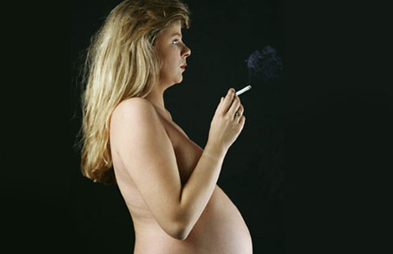
STOP!!! Think about your child.

Slide 3
Smoking is a cause of lung’s cancer.
Healthy tissue of lungs
sore tissue of lungs

Slide 4
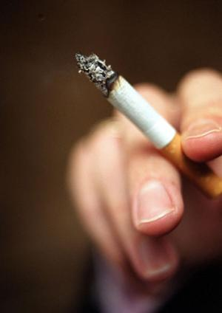
Smoking is often considered antisocial!
Many people don’t like
Ash trays full of cigarette-ends
Or the sight of the smokers stained fingers
smell of cigarettes

Slide 5
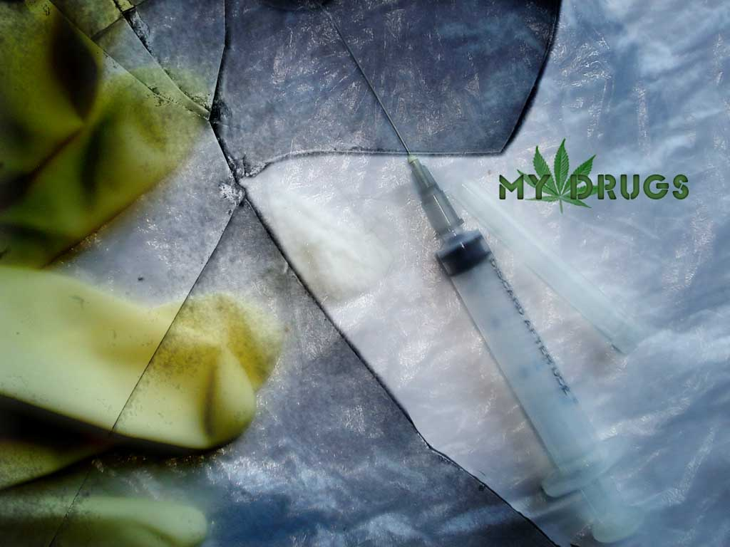
Drugs

Slide 6
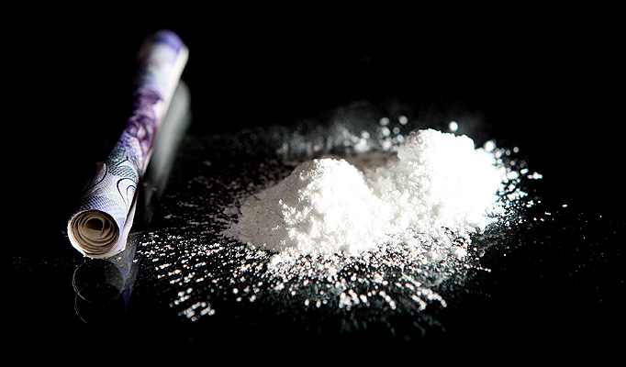
Even in small amounts, drugs can caused sudden death in some people. Children born to drug-addicted parents can be affected.

Slide 7
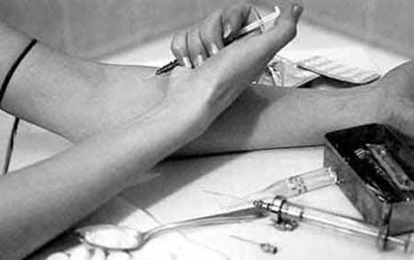
Intravenous drugs are cause of AIDS

Slide 8
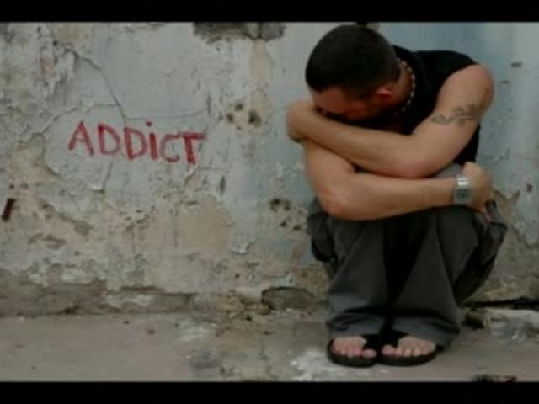
People take drugs because they think they make them feel better! Many young people think that they help decide them problems!! But drugs simply make the problem worse!!!

Slide 9
Alcohol

Slide 10
Alcohol makes people think they are brilliant drivers. But they become a risk to other drivers and pedestrians-potential killers.

Slide 11
Alcohol is a mild poison.
stomach
Heart
intestines
liver
immunity
brain
It destroys everything in our organism.

Slide 12
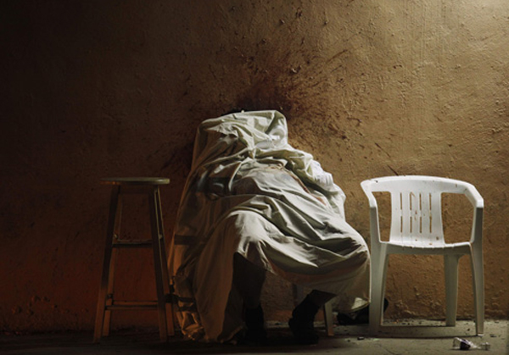
Drugs, alcohol and smoking kill slowly.
S
T
O
P

