Slide 1
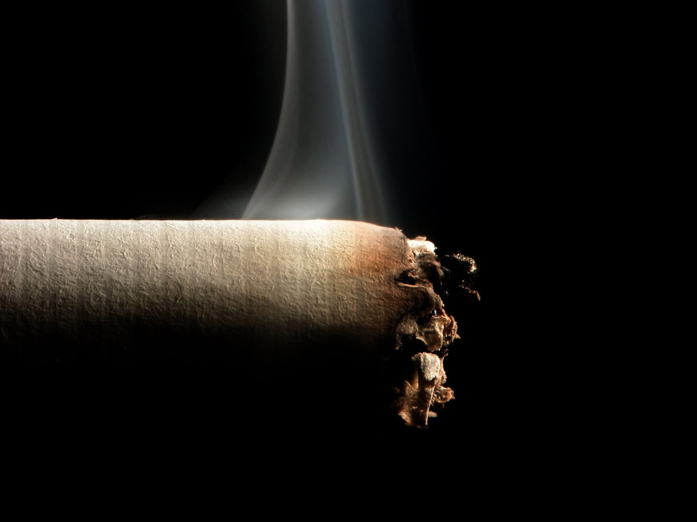
???Why are people smoking???

Slide 2
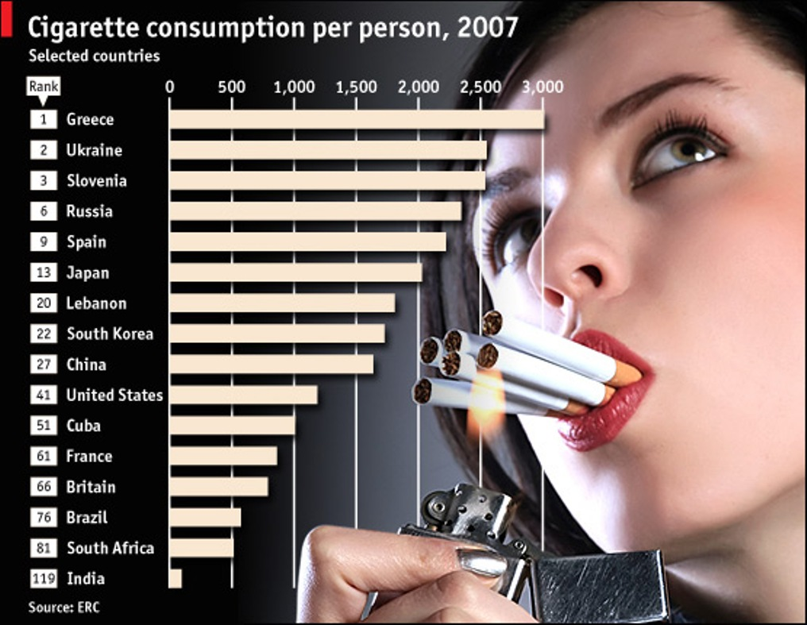

Slide 3
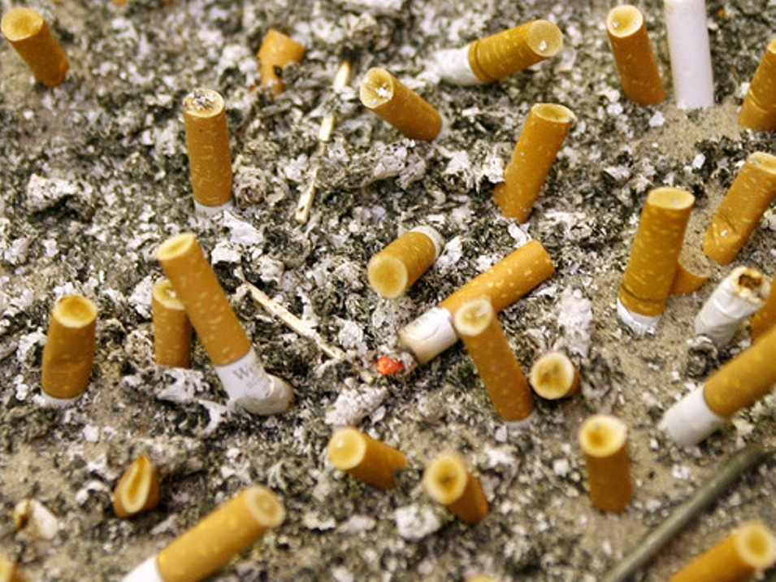
What makes them to reduce their life and to poison their organisms?
It’s a habit!!....

Slide 4
Smoking is capable of reducing the life of a smoker
more than on 15 years!!!....

Slide 5
Recent researches
of the scientists
have showed that
nicotine in small
portions can be
even useful for an
organism, while
burning of a nicotine’s
List, i.e. tobacco smoke, gives the most
dreadful harm…..

Slide 6
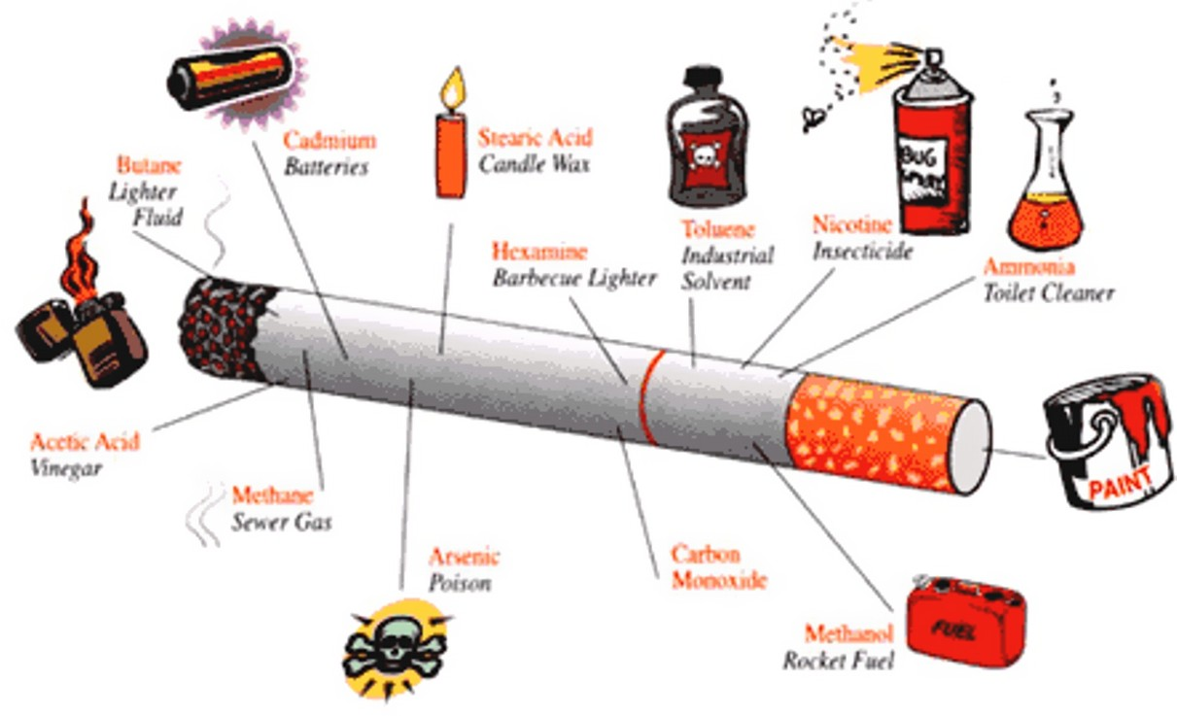

Slide 7
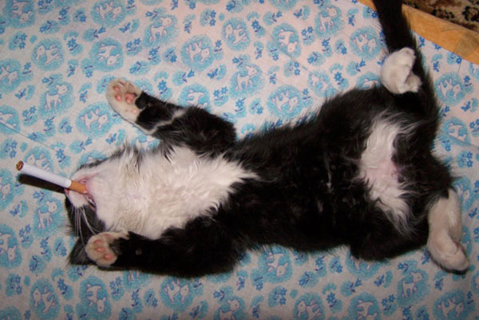
A smoker receives about 5000 harmful
things
together with tobacco smoke!!...

Slide 8
Today about 15 kinds of swellings
which are caused by smoking.

Slide 9
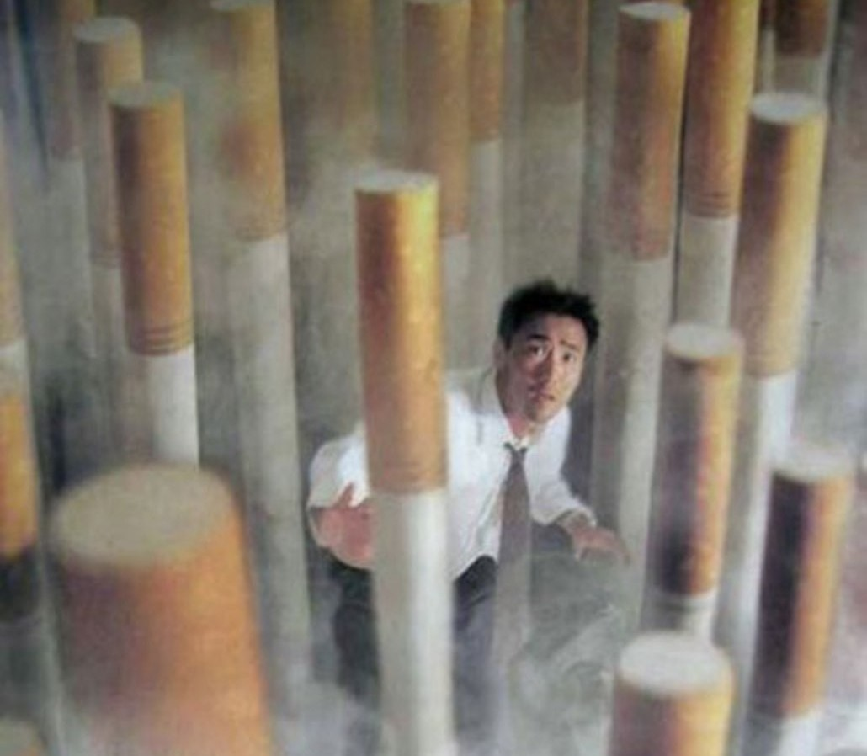
You can meet almost all table
of
Mendeleev:
mercury,
lead,
cooper and
other…

Slide 10
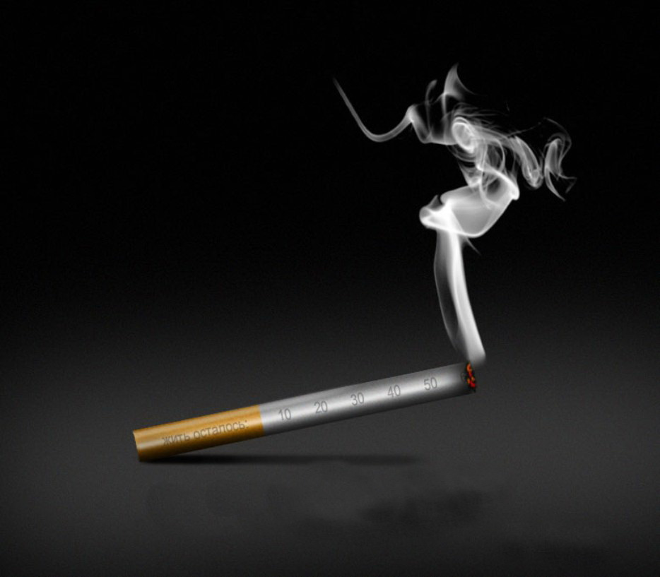
Smoking causes harm for hearts and vessels!..

Slide 11
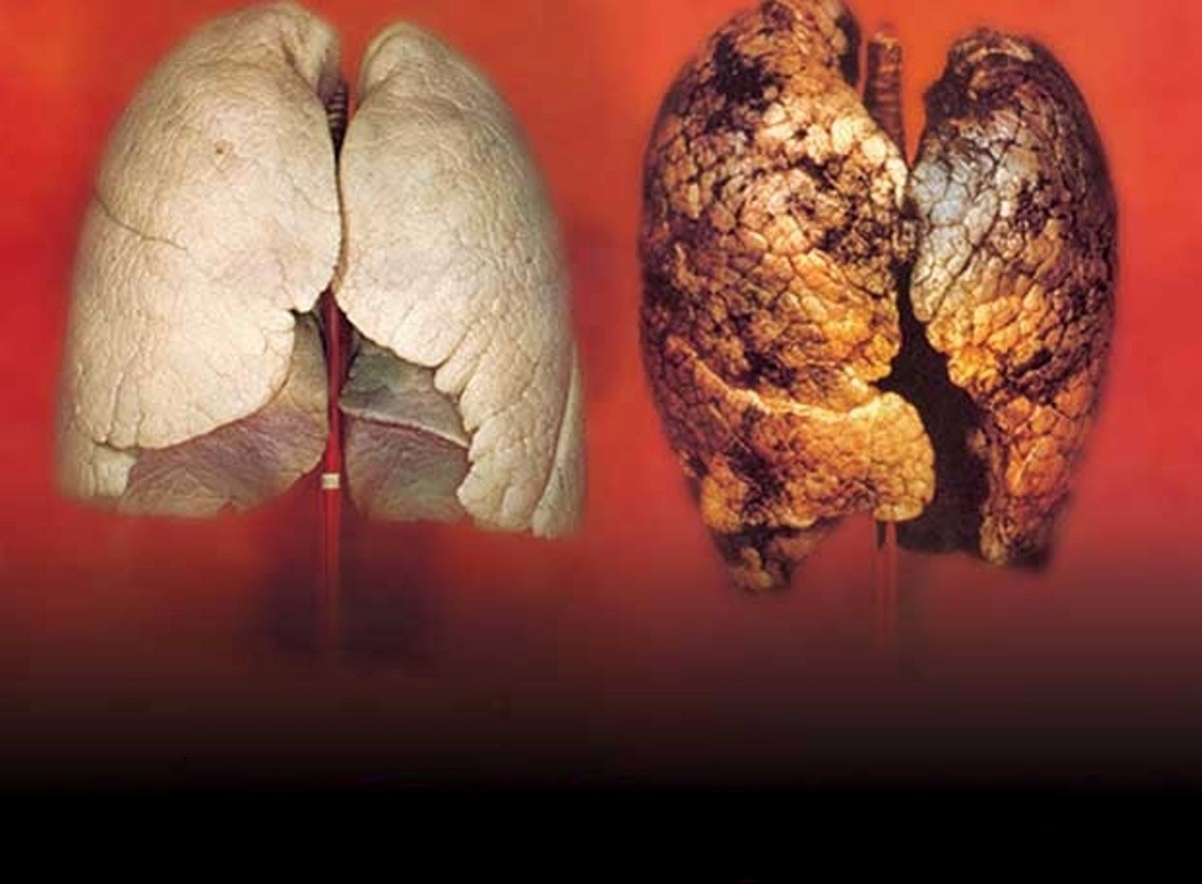
Chronic bronchitis occurs when tar and mucus
damage the air sacks in the lungs…

Slide 13
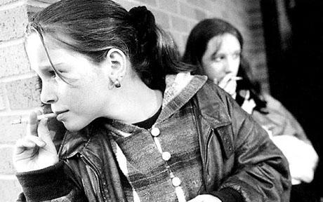
Women have a great
change to remain
without child.
If you want to have a
baby you should
give up smoking
in a year and
a half of year before
being pregnant.

Slide 14
Dear girls and women!!! Smoking
isn’t a modern habit now. A
woman sitting and
smoking hasn’t respect for people
who are around her. Men don’t
respect women who are smoking.
They like women who have a
smell of freshness but not a smell
tobacco!!!.......

Slide 15
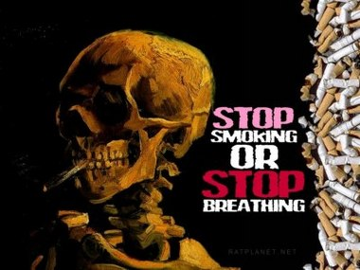

Slide 18
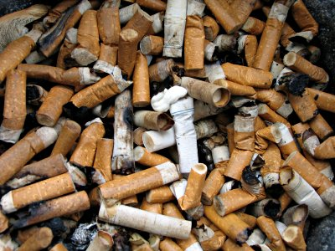

Slide 20
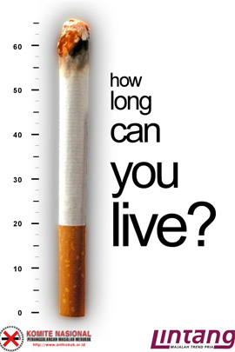
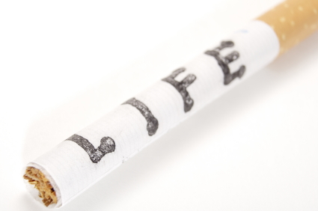

Slide 26
